Slide 1
Data Structures Workshop
Day 12

Slide 2
Workshop Outline
Quick Stack Recap
Infix and Postfix Notation
Infix to Postfix
Evaluate Postfix

Slide 3
Stacks

Slide 4
Getting Rid of Duplicates
FROM LAST WORKSHOP
Given a string, find the adjacent duplicates(two of the same character beside each other) and remove them using the stack.
Input: s = "abbaca
Ouput: "ca"

Slide 5
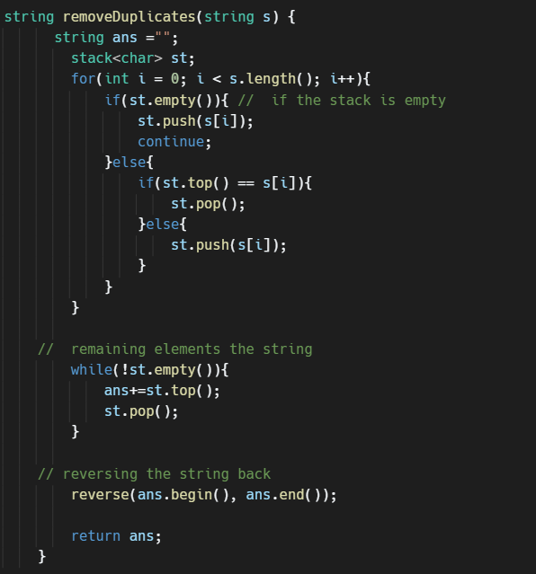
Solution

Slide 6
Redundant Brackets
Given an expression, find out whether or not that expression contains redundant brackets. The function should return true if the expression contains redundant brackets and false otherwise.
redundantBrackets(“((a+b))”) => true
redundantBrackets(“a*(b+c)”) => fasle

Slide 7
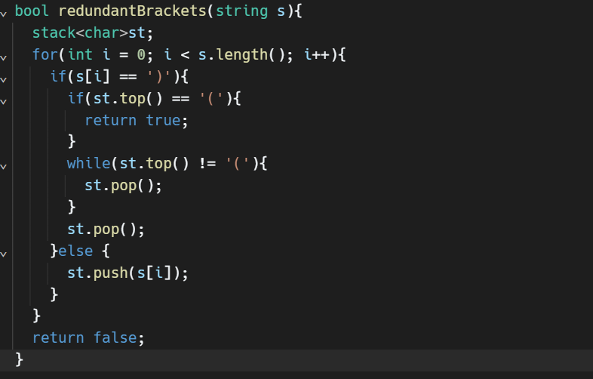
Solution

Slide 8
Infix and Postfix Expressions

Slide 9
Why Are They Used?
When writing complex mathematical expressions, we usually use parentheses to make them more readable, such as:
Ex. ((3 + 5) * 7) / (23 + 9)
In computers though, dealing with all these sets of parentheses takes more work when trying to evaluate these expressions.
This is why various notations (such as infix and postfix ones) have been made!

Slide 10
What is Infix and Postfix Notation?
Infix Notation - The typical mathematical form of expression that we encounter. In infix form, an operator is written in between two operands
Ex. A * (B + C) / D
Postfix (“Reverse Polish”) Notation - In postfix notation, an operator is written after its operands
Ex. A B C + * D /

Slide 11
Evaluating the Expressions
So now that we know what these notations are, how do we actually deal with evaluating them?...
We first need to convert an infix expression to a postfix one, then after that, we can evaluate the postfix expression
Stacks!

Slide 12
Infix to Postfix
Read string by iterating through each character
If the character is an operand (a, b, c, etc.), then we directly output it
If the character is an operator (+, -, *, etc.), then we push it to our stack
Each one of our operators have a priority, so check it:
() → ^ → * or / → + or -
If our stack is empty, then push the operator into it
If the priority of the operator is GREATER than priority of operator on top of stack, push new operator to top of stack
If the priority of the operator is LESS or EQUAL than priority of operator on top of stack, pop and output operators in stack until the priority of the operator you want to push is GREATER than the one on top of stack (or until stack is empty, to which you can then push new operator)
In case of parenthesis, push opening parentheses, then push operator
When you reach a closing parentheses, pop and output operators until you reach an opening one (which you will discard)
If you reach end of string and the stack isn’t empty, pop and output all operators in stack until it’s empty

Slide 13
Infix to Postfix (Tracing)
Ok, that was a lot of information…
Let’s do an example by hand to understand
Ex. a * b - c + (d - e) / f​

Slide 14
Implement It Yourself!
Write a function that takes in an infix expression and returns a string of the expression in postfix notation
Input: 1+2*(6-3)
Output: 1263-*+
You may assume all operands will be integers, the operators used can be (, ), ^, *, /, +, and -
Can also ignore whitespace

Slide 15
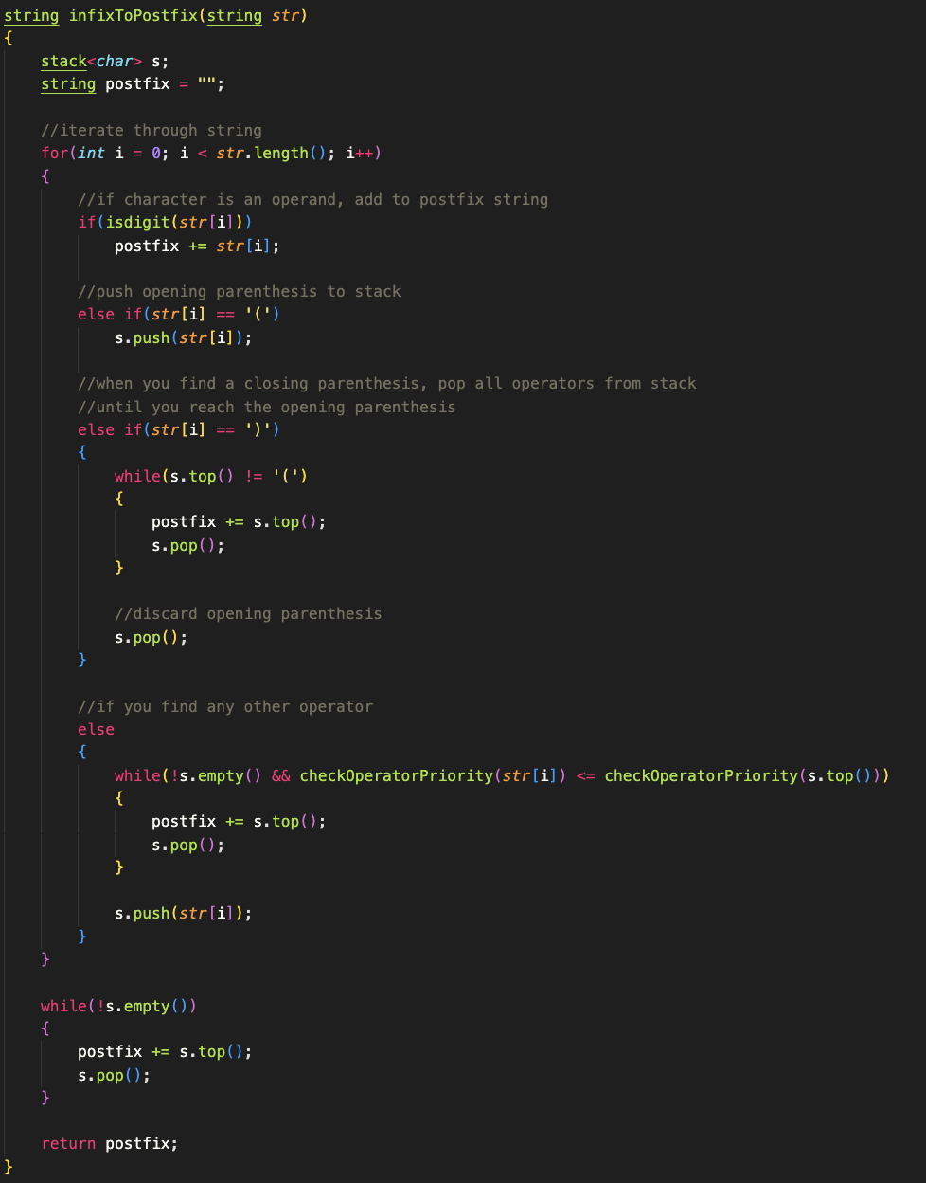
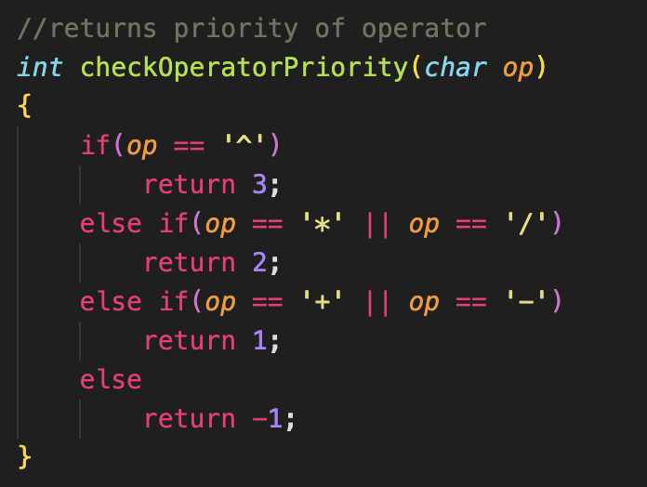
Solution

Slide 16
Dealing with Postfix…
After we convert our infix expression to a postfix one, we’re left with… this…?
1263-*+
What are we supposed to do with that?!
Once again, we can use a stack to help evaluate this!
Take a couple of minutes to try to figure out how to evaluate this expression.

Slide 17
Evaluating a Postfix Expression
Last time around, we pushed our operators into our stack. Now, we’re going to push the operands into the stack!
Push operands into the stack
If you come across an operator, pop the first two elements in the stack and apply that operation to the two popped elements and push the “solution” back into the stack
([secondDigit] [operator] [firstDigit])
Continue until you reach the end of the string!

Slide 18
Implement It Yourself!... Again!
Write a function that takes in a string expression (in postfix notation) and returns an integer that contains the solution to the expression.
Input: 1263-*+
Output: 7
You may assume all operands will be integers, the operators used can be (, ), ^, *, /, +, and -
Can also ignore whitespace

Slide 19
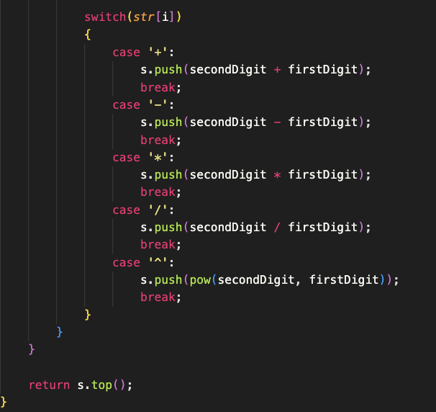
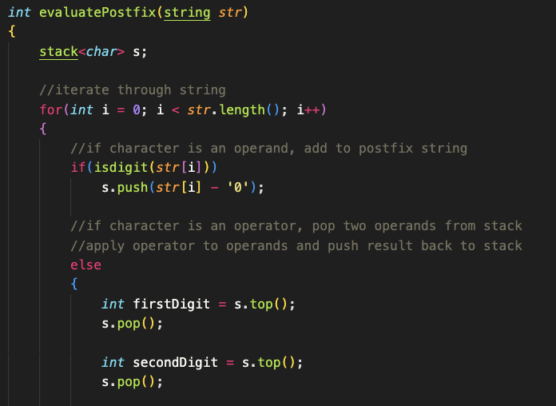
Solution

